Slide 1
Computer Engineering Department
A.P. Shah Institute of Technology
G.B.Road,Kasarvadavali, Thane(W), Mumbai-400615 UNIVERSITY OF MUMBAI
Academic Year 2022-2023

Slide 2
Hospital Management System
A Project Report on
Submitted in partial fulfillment of the degree of
Bachelor of Engineering(Sem-VI)
in
Computer Engineering
By
Mahek Chougule (20102184)
Anjali Divekar (21202105)
Vaishnavi Dhumal(21202146)
Under the Guidance of
Prof. D.D. Kayande

Slide 3
1.Project Conception and Initiation

Slide 4
1.1 Abstract
In today's world, the healthcare industry is a vital part of our society. The healthcare industry's operations involve the management of patient information, scheduling appointments, managing medical records, and many other tasks. The traditional paper-based methods of managing these tasks are inefficient and time-consuming, leading to errors and delays in patient care. A hospital management system is a critical software application that helps healthcare providers manage their operations efficiently.

Slide 5
1.2 Objectives
To design an efficient database schema that can handle complex relationships between entities such as patients, doctors, and medical procedures while ensuring data protection and security.
To develop a user-friendly and intuitive interface that can be easily used by healthcare providers with minimal training.
To provide healthcare providers with an efficient and reliable way to manage their operations and improve patient care.
To host the system on AWS, providing scalability, reliability, and security features that ensure the system remains operational and secure.
To improve the efficiency of healthcare operations by providing healthcare providers with a platform to manage patient information, appointment scheduling, and billing information efficiently.

Slide 6
1.3 Problem Definition
The healthcare industry is one of the most critical industries globally, and efficient management of healthcare operations is crucial to ensure high-quality patient care. The traditional paper-based methods of managing healthcare operations can be time-consuming, error-prone, and inefficient, leading to delays in patient care and increased costs. Hospital management systems can help healthcare providers manage their operations more efficiently and improve patient care.
Another problem is designing a user-friendly and intuitive interface that can be easily used by healthcare providers with minimal training. The interface must provide easy access to patient information, appointment scheduling, and billing information.

Slide 7
1.4 Scope
The system will be a web-based application that can be accessed from any device with an internet connection.
The system will be designed to manage hospital operations such as patient information management, appointment scheduling, and billing information management.
The system will be designed to be user-friendly and intuitive, allowing healthcare providers to manage their operations efficiently with minimal training.
The system will be designed to be scalable, reliable, and secure, ensuring that healthcare providers can access patient information and manage their operations from anywhere at any time.
The system will be hosted on the AWS cloud platform using Elastic Beanstalk, providing scalability, reliability, and security features that ensure the system remains operational and secure.

Slide 8
1.5 Technology stack
Front-end: HTML, CSS, JS
Back-end: PHP
Software used: XAMPP
IDE used: VSCODE

Slide 9
1.6 Benefits for environment & Society
Reduced paper waste
Improved efficiency in hospital operations
Enhanced data security through data encryption, access control, and backup and recovery capabilities
Improved accessibility for patients and healthcare providers through remote access to patient data and other hospital-related information
Contributing to a more sustainable and environmentally-friendly healthcare system

Slide 10
2. Cloud Technology

Slide 11
2.1 Cloud Platform
We have opted to use AWS service to deploy our project on the cloud. This allows us to leverage the scalability, reliability, and security features of AWS to ensure seamless deployment and management of our project. With AWS, we can easily monitor and manage our resources, ensuring optimal performance and efficiency.

Slide 12
2.2 Services Used
Elastic Beanstalk:
Elastic Beanstalk is a platform offered by Amazon Web Services (AWS) that simplifies the process of deploying, scaling, and managing web applications. In the hospital management system project, Elastic Beanstalk can be used to streamline the deployment process of the web-based application.
With Elastic Beanstalk, developers can simply upload their application code and Elastic Beanstalk will automatically handle the deployment of the application, including provisioning the necessary infrastructure, such as EC2 instances, load balancers, and databases. Elastic Beanstalk also provides autoscaling capabilities, allowing the application to automatically scale up or down based on demand.

Slide 13
2.2 Services Used
RDS:
Amazon Relational Database Service (RDS) is a fully managed database service offered by AWS that simplifies the process of setting up, operating, and scaling a relational database. In the hospital management system project, RDS can be used to manage the SQL database that stores the data for the web-based application.
RDS is a fully managed database service, meaning that AWS takes care of the maintenance, backups, and updates for the database, allowing developers to focus on the application logic.

Slide 14
3.Implementation

Slide 15
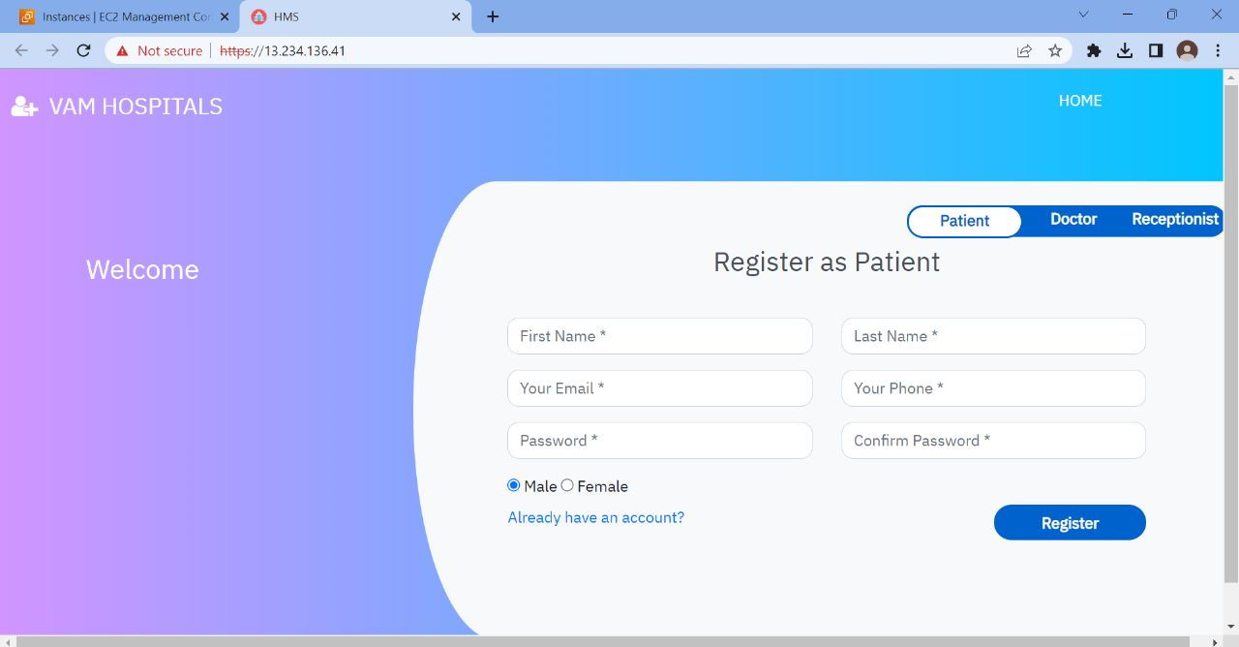
3.1 Execution

Slide 16
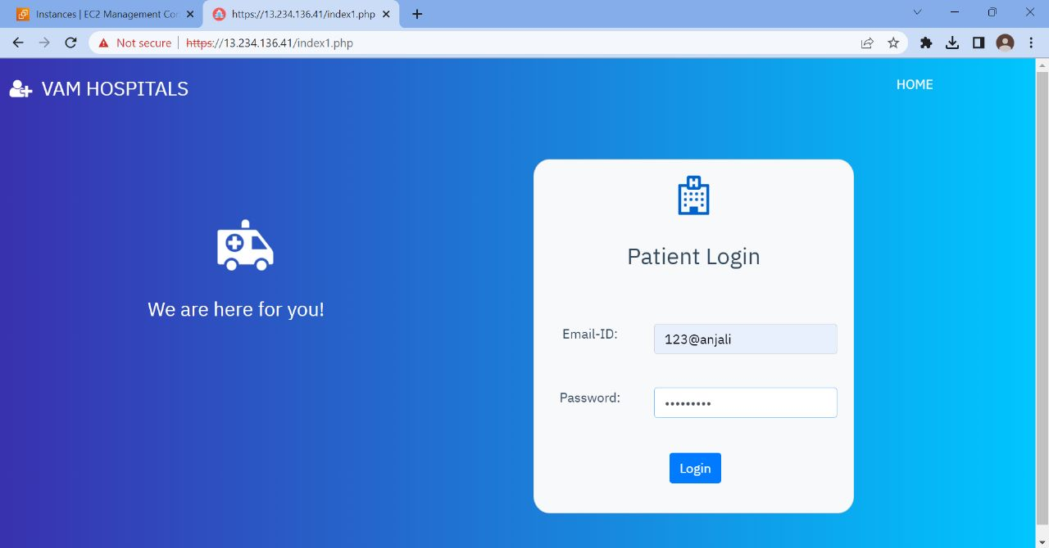

Slide 17
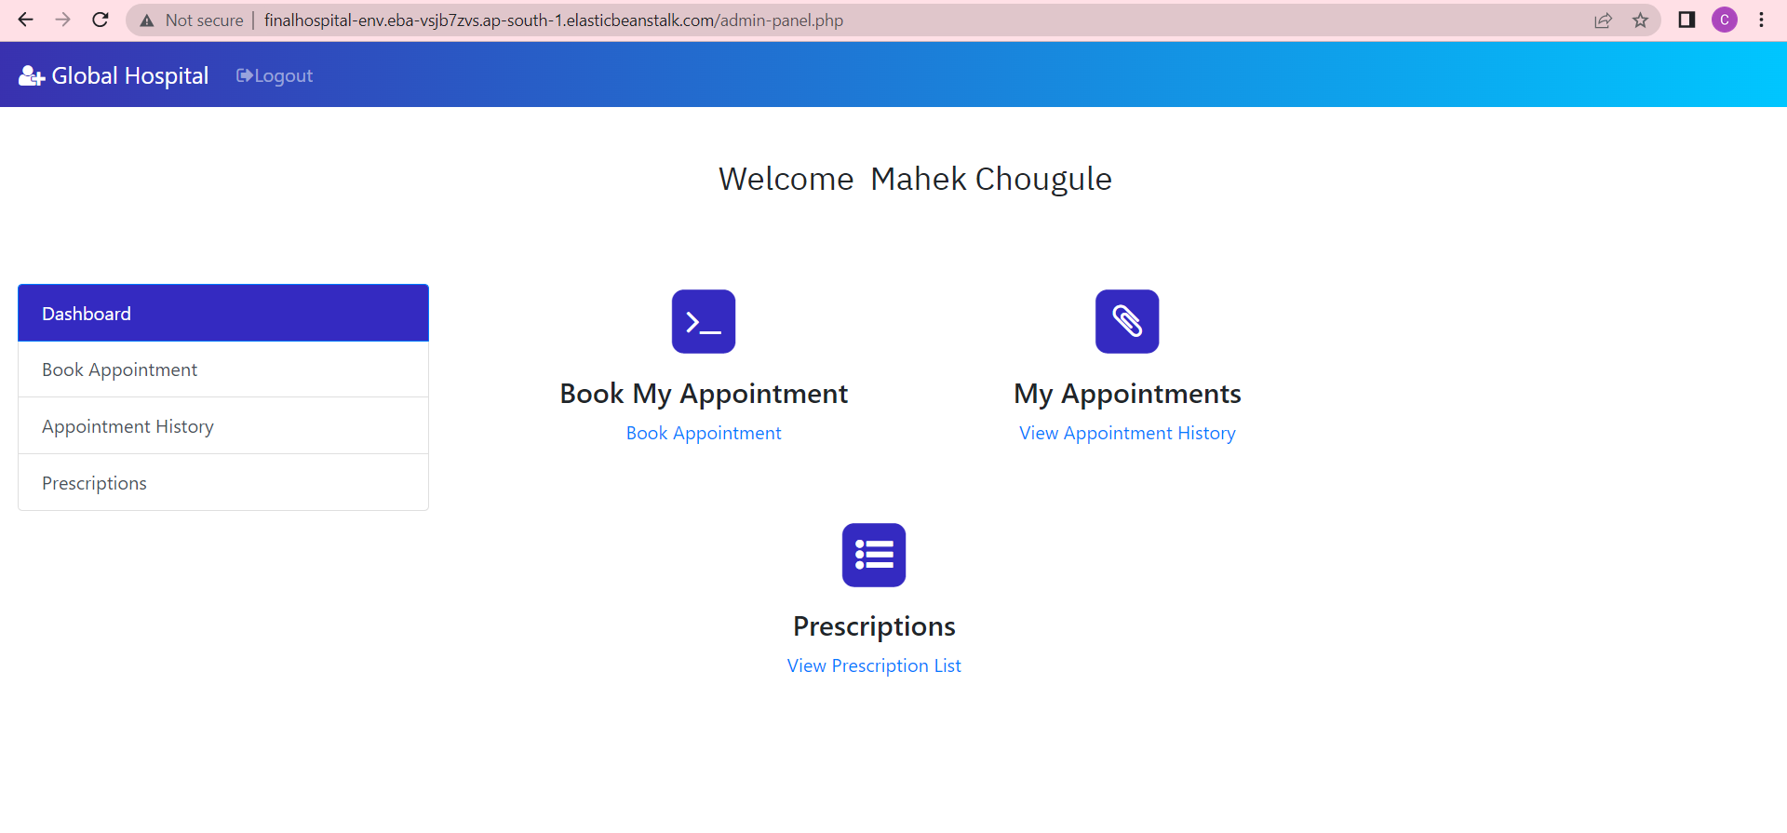

Slide 18
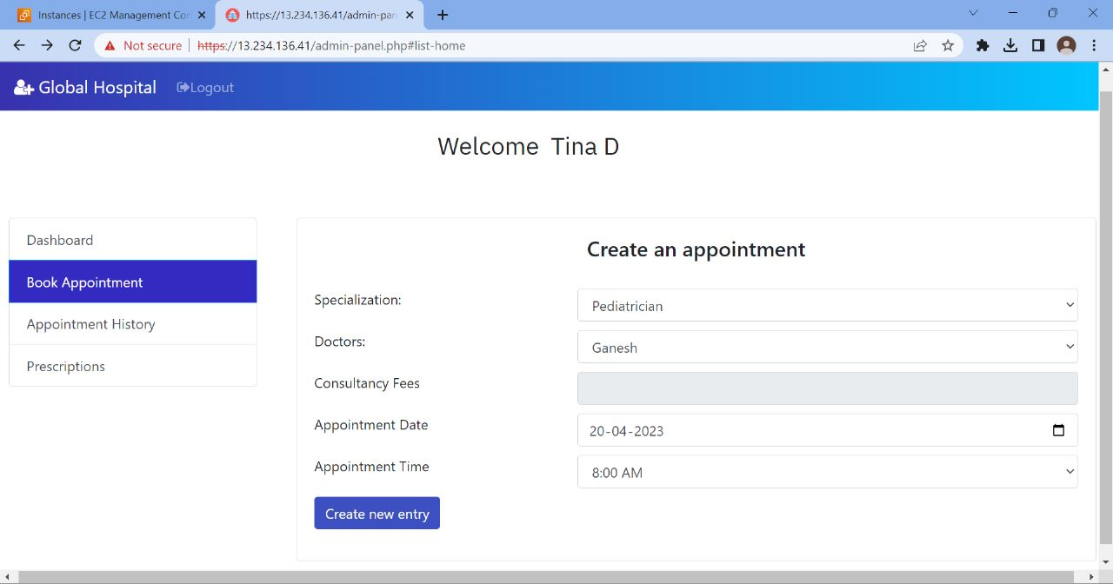

Slide 19
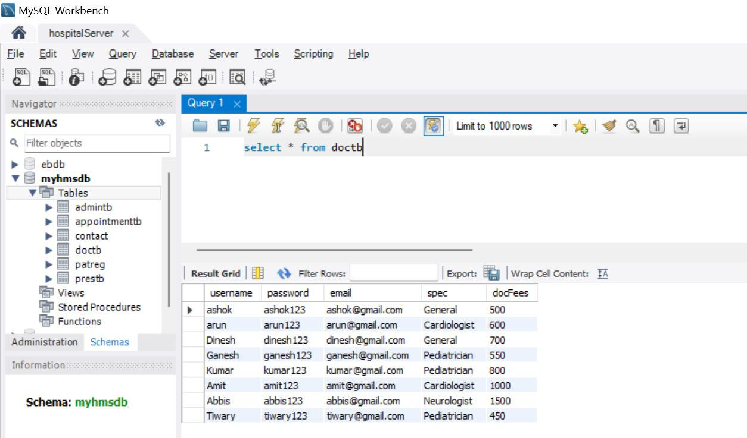

Slide 20
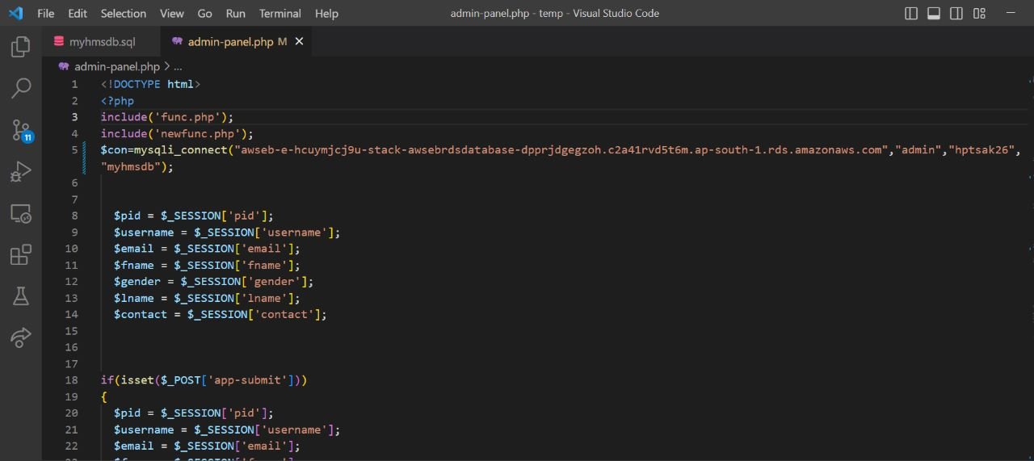

Slide 21
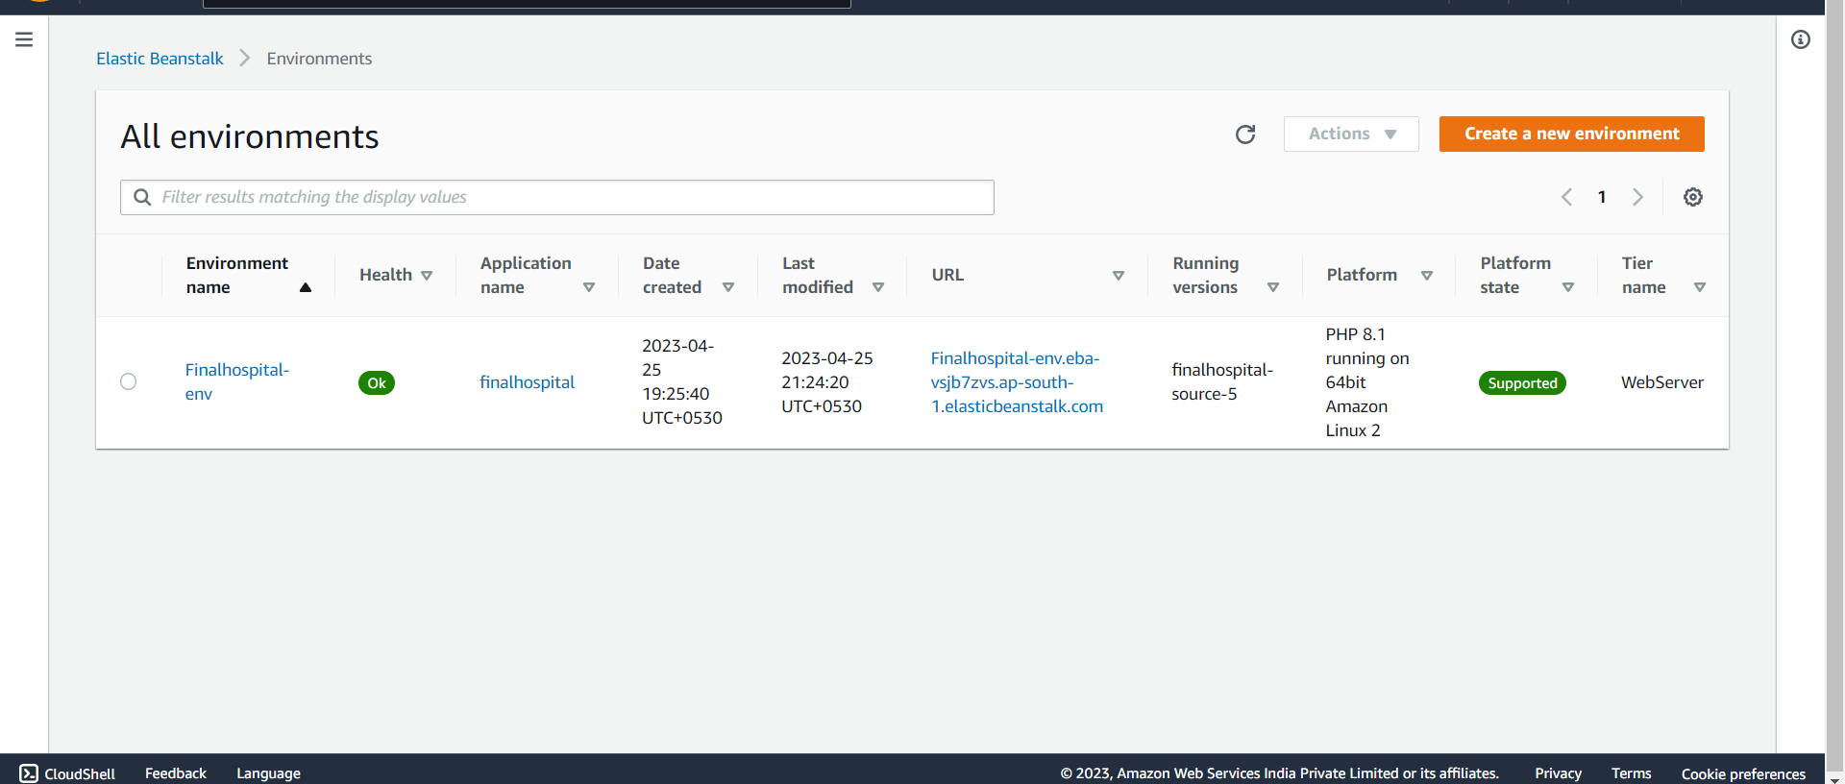

Slide 22
5. References
Journal of Computer Applications, vol. 108, no. 4, pp. 1-4, December 2014.
A. Garg, N. B. R. Subramanya, and G. R. Kini, "Design and Implementation of Hospital Management System Using PHP and MySQL," International Journal of Emerging Technology and Advanced Engineering, vol. 3, no. 3, pp. 66-70, March 2013.
S. P. Singh and P. Kumar, "Hospital Management System: A Review," International Journal of Advanced Research in Computer Science and Software Engineering, vol. 4, no. 7, pp. 847-852, July 2014.
A. M. A. Al-Ali and M. A. El-Mahallawy, "Cloud Computing in Healthcare: A Literature Review," Journal of Healthcare Engineering, vol. 2018, Article ID 9096061, 12 pages, 2018.
R. K. Singh and R. C. Jain, "Design and Development of Cloud-Based Hospital Management System Using AWS," International Journal of Computer Sciences and Engineering, vol. 6, no. 11, pp. 283-287, November 2018.

Slide 23
Demonstration and Code Links
https://github.com/anjalid26/Hospital-Management-System

Slide 24
Thank You

